Slide 1

Fraud Detection in Online Product Review Systems via Heterogeneous Graph Transformer Presented By: G .LOKESH 20R01A67D4 G.MOUNIKA 20R01A67D9 M.YUKTA SHREYA 20R01A67F9 NCH.SRAVANI 20R01A67G4

Slide 2
ABSTRACT
In online product review systems, users are allowed to submit reviews about their purchased items or services. However, fake reviews posted by fraudulent users often mislead consumers and bring losses to enterprises. Traditional fraud detection algorithm mainly utilizes rule-based methods, which is insufficient for the rich user interactions and graph-structured data. In recent years, graph-based methods have been proposed to handle this situation, but few prior works have noticed the camouflage fraudster’s behavior and inconsistency heterogeneous nature. Existing methods have either not addressed these two problems or only partially, which results in poor performance. Alternatively, we propose a new model named Fraud Aware Heterogeneous Graph Transformer(FAHGT), to address camouflages and inconsistency problems in a unified manner. FAHGT adopts a type-aware feature mapping mechanism to handle heterogeneous graph data, then implementing various relation scoring methods to alleviate inconsistency and discover camouflage. Finally, the neighbors’ features are aggregated together to build an informative representation. Experimental results on different types of real-world datasets demonstrate that FAHGT outperforms the state-of-the-art baselines.

Slide 3
INTRODUCTION
In online product review systems, users are allowed to submit reviews about their purchased items or services. However, fake reviews posted by fraudulent users often mislead consumers and bring losses to enterprises. Traditional fraud detection algorithm mainly utilizes rule-based methods, which is insufficient for the rich user interactions and graph-structured data. In recent years, graph-based methods have been proposed to handle this situation, but few prior works have noticed the camouflage fraudster’s behavior and inconsistency heterogeneous nature. Existing methods have either not addressed these two problems or only partially, which results in poor performance. Alternatively, we propose a new model named Fraud Aware Heterogeneous Graph Transformer(FAHGT), to address camouflages and inconsistency problems in a unified manner. FAHGT adopts a type-aware feature mapping mechanism to handle heterogeneous graph data, then implementing various relation scoring methods to alleviate inconsistency and discover camouflage. Finally, the neighbors’ features are aggregated together to build an informative representation. Experimental results on different types of real-world datasets demonstrate that FAHGT outperforms the state-of-the-art baselines.

Slide 4
PROBLEM DEFINITION
Graph-based Fraud Detection. Given a set of nodes V, the node feature matrix X and its corresponding graph G, our aim is to justify the node’s suspicious Y by finding an optimal detector f such that Y = f(X, G). Y ∈ {0, 1}, where 0 represents benign and 1 represents suspicious. The detector f is trained based on the labeled node information in a semi-supervised manner. For example, the node could be an account in a transaction system or a user in a social network. The edges could be transactions between accounts or contacts between users. The suspicious label could be determined by whether a user has posted spam content.

Slide 5
EXISTING SYSTEM
In recent years, lots of heterogeneous GNN based methods have been developed. HAN , HAHE, and Deep- HGNN transforms a heterogeneous graph into several homogeneous graphs based on handcrafted meta-paths, applies GNN separately on each graph, and aggregates the output representations by attention mechanism. GraphInception constructs meta-paths between nodes with the same object type. Het GNN first samples a fixed number of neighbors via random walk strategy. Then it applies a hierarchical aggregation mechanism for intra-type and intertype aggregation. HGT extends transformer architecture to heterogeneous graphs. They directly calculate attention scores for all the neighbors of a target node and perform aggregation accordingly without considering domain knowledge.
For relation-aware graph fraud detectors, their main solution is to build multiple homogeneous graphs based on edge type information of the original graph then perform type independent node level aggregation and graph level concatenation. GEM learns weighting parameters for different homogeneous subgraph. Player2Vec and SemiGNN both adopt attention mechanism in feature aggregation and Semi GNN further leverages a structure loss to guarantee the node embeddings homophily. Some works directly aggregate heterogeneous information in the graph. For instance, under a user-review-item heterogeneous graph, GAS learns a unique set of aggregators for different node types and updates the embeddings of each node type iteratively.

Slide 6
DISADVANTAGES OF EXISTING SYSTEM
In the existing work, the system did not implement Fraud Aware Heterogeneous Graph Transformer(FAHGT) to measure frauds exactly.
This system is less performance due to lack of META RELATION SCORING.

Slide 7
PROPOSED SYSTEM
Graph Consis addresses the inconsistency problem by computing the similarity score between node embeddings, which cannot distinguish nodes with different types. CAREGNN enhances GNN-based fraud detectors against camouflaged fraudsters by reinforcement learning based neighbor selector and relation aware aggregator. Its performance still suffers from the heterogeneous graph.
In this paper, the system introduces the Fraud Aware Heterogeneous Graph Transformer(FAHGT), where we propose heterogeneous mutual attention to address the inconsistency problem and design a label-aware neighbor selector to solve the camouflage problem. Both are implemented in a unified manner called the “score head mechanism”. We demonstrate the effectiveness and efficiency of FAHGT on many real world datasets. Experimental results suggest that FAHGT can significantly improve KS and AUC over state-of-the-art GNNs as well as GNN-based fraud detectors.

Slide 8
Advantages OF PROPOSED SYSTEM
Heterogeneity: FAHGT is able to handle heterogeneous graphs with multi-relation and multi-node type without designing meta-path manually.
Adaptability: FAHGT attentively selects neighbors given a noise graph from real-world data. The selected neighbors are either informative for feature aggregation or risky for fraud detection.
Efficiency: FAHGT admits a low computational complexity via a parallelizable multi-head mechanism in relation scoring and feature aggregation.
Flexibility: FAHGT injects domain knowledge by introducing a flexible relation scoring mechanism. The score of a relation connecting two nodes not only comes from direct feature interaction but is also constrained by domain knowledge.

Slide 9
SYSTEM REQUIREMENTS
H/W System Configuration:
Processor - Pentium –IV
RAM - 4 GB (min)
Hard Disk - 20 GB
Key Board - Standard Windows Keyboard
Mouse - Two or Three Button Mouse
Monitor - SVGA

Slide 10
SOFTWARE REQUIREMENTS:
Operating system : Windows 7 Ultimate.
Coding Language : Python.
Front-End : Python.
Back-End : Django-ORM
Designing : Html, css, javascript.
Data Base : MySQL (WAMP Server).

Slide 11
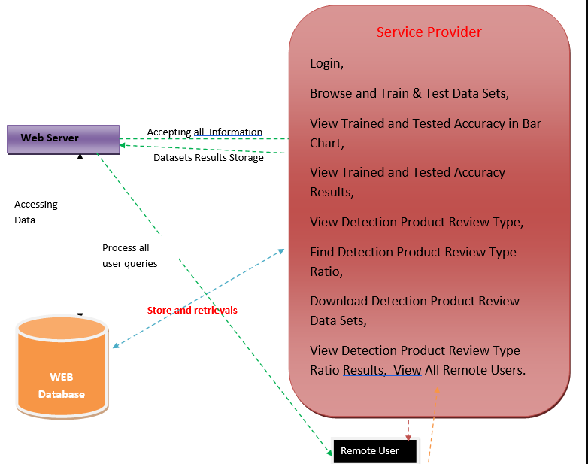
SYSTEM DESGIN
SYSTEM ARCHITECTURE

Slide 12
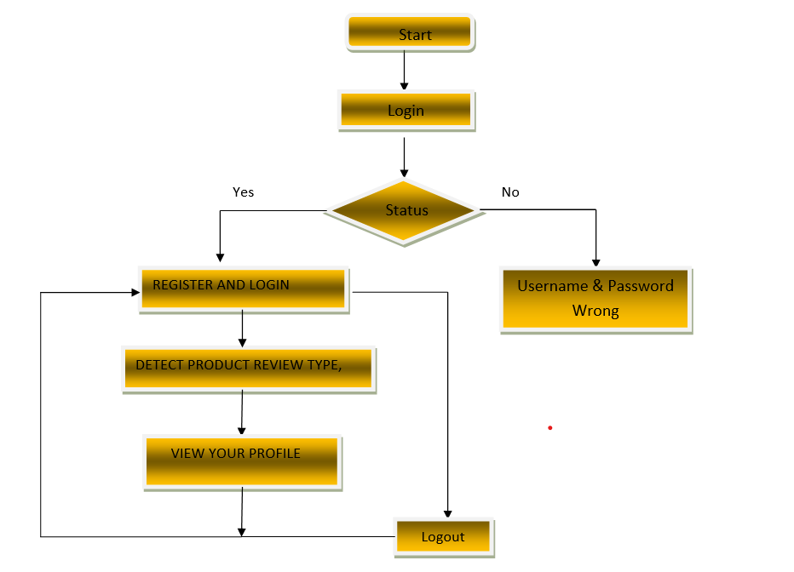
FLOW CHART DIAGRAM

Slide 13
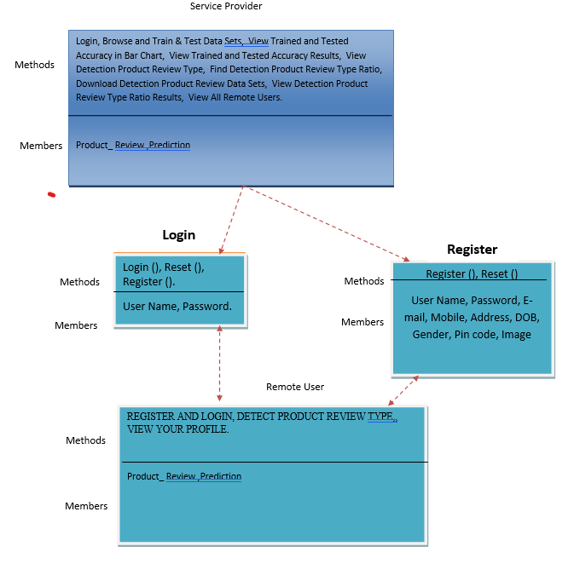
CLASS DIAGRAM

Slide 14
IMPLEMENTATION
Service Provider
In this module, the Service Provider has to login by using valid user name and password. After login successful he can do some operations such as
Login, Browse and Train & Test Data Sets, View Trained and Tested Accuracy in Bar Chart, View Trained and Tested Accuracy Results, View Detection Product Review Type, Find Detection Product Review Type Ratio, Download Detection Product Review Data Sets, View Detection Product Review Type Ratio Results, View All Remote Users.
View and Authorize Users
In this module, the admin can view the list of users who all registered. In this, the admin can view the user’s details such as, user name, email, address and admin authorizes the users.
Remote User
In this module, there are n numbers of users are present. User should register before doing any operations. Once user registers, their details will be stored to the database. After registration successful, he has to login by using authorized user name and password. Once Login is successful user will do some operations like REGISTER AND LOGIN, DETECT PRODUCT REVIEW TYPE, VIEW YOUR PROFILE.

Slide 15
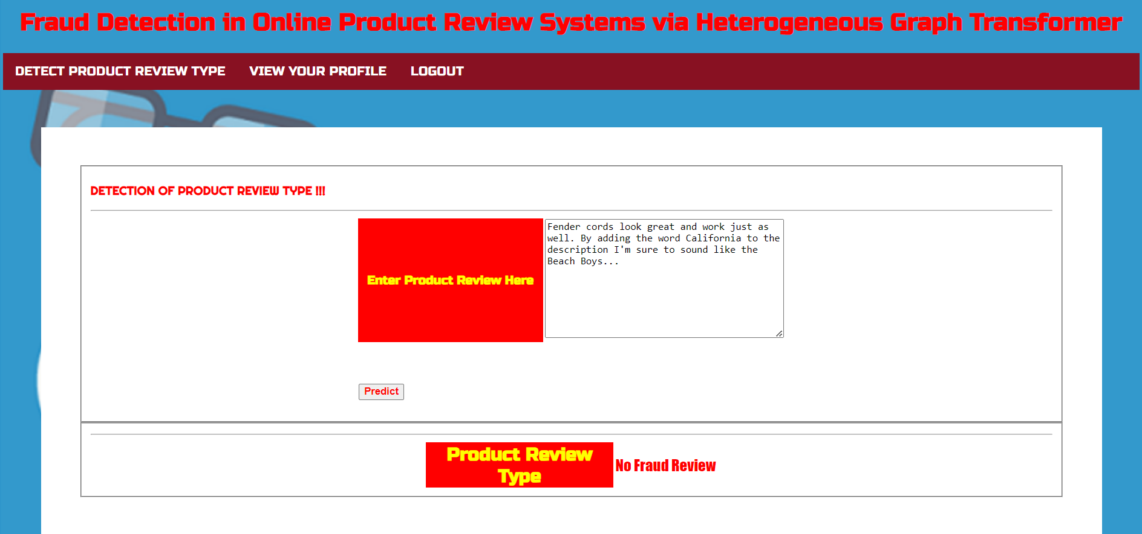
OUTPUT SCREENSHOT

Slide 16
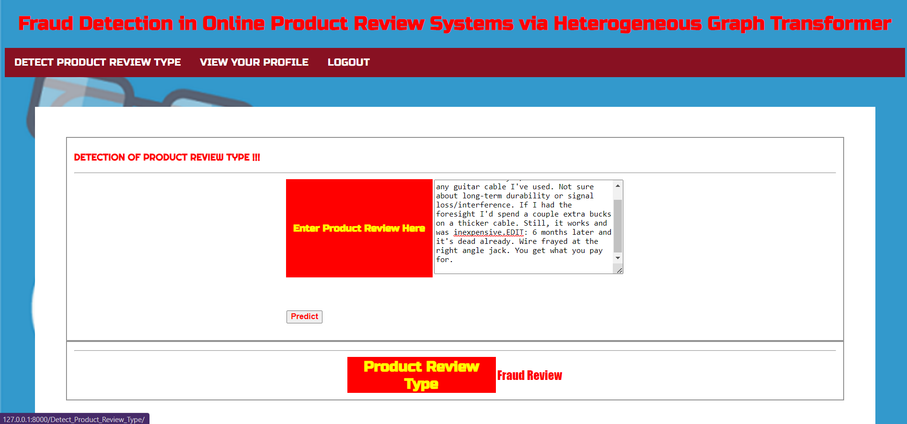
OUTPUT SCREENSHOT

Slide 17
CONCLUSION AND FUTURE ENHANCEMENTS
In this paper, we propose FAHGT, a novel heterogeneous graph neural network for fraudulent user detection in online review systems. To handle inconsistent features, we adopt heterogeneous mutual attention for automatic meta path construction. To detect camouflage behaviors, we design the label aware scoring to filter noisy neighbors. Two neural modules are combined in a unified manner called “score head mechanism” and both contribute to edge weight computation in final feature aggregation. Experiment results on real-world business datasets validate the excellent effect on fraud detection of FAHGT. The hyper-parameter sensitivity and visual analysis further show the stability and efficiency of our model. In summary, FAHGT is capable of alleviating inconsistency and discover camouflage and thus achieves state-of-art performance in most scenarios. In the future, we plan to extend our model in handing dynamic graphs data and incorporate fraud detection into other areas, such as robust item recommendation in E-commerce or loan default prediction in financial services.

Slide 18
THANK YOU

